Slide 1
Like* Partner Data
December 11, 2020

Slide 2
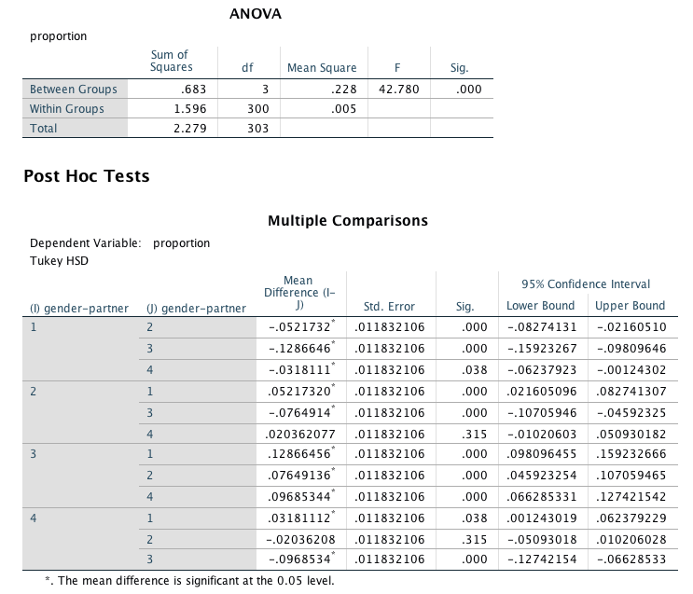
alone
male
female
both

Slide 3
.13 %
.06 %
.04 %
.006 %

Slide 4
To do next:
Random sampling to compare male vs. female participants
Like* alternatives (about, almost, approximately)
Parent data
Zip code data
Code “uh” and “um”

Slide 5
Like* Partner Data
February 5, 2021

Slide 6
45%
Like* Files w/ Male
Valid Male Files
24%
15%

Slide 7
33%
29%
Like* Files w/ Male
Valid Male Files
22%
**
Notes:
Could break this up based on female/male participants, too (mixed model)

Slide 8
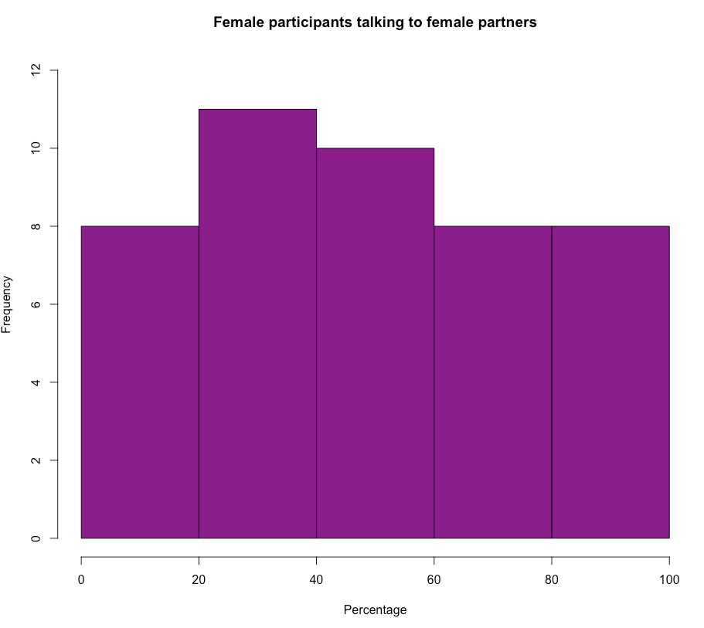
How often are Females talking to Females?
Female participants only, N=45
Valid Female Files
Total Valid Files

Slide 9
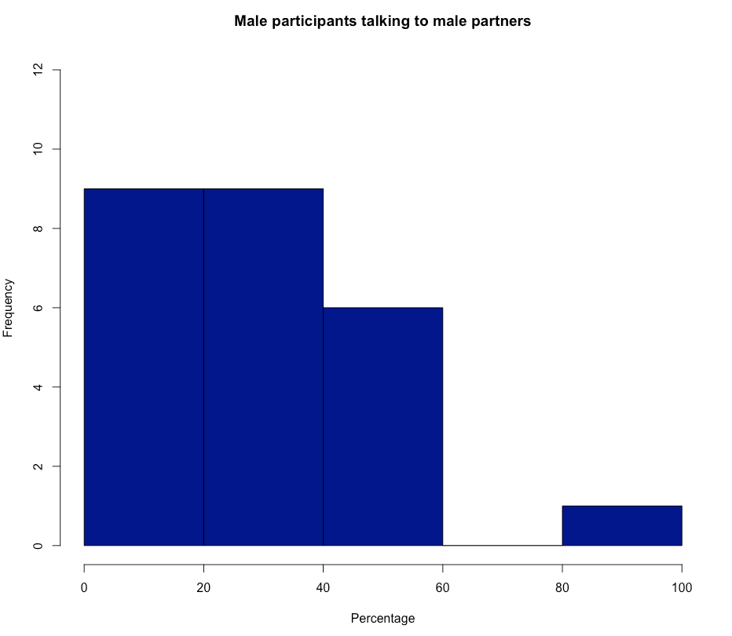
How often are Males talking to Males?
Male participants only, N=25
Valid Male Files
Total Valid Files

Slide 11
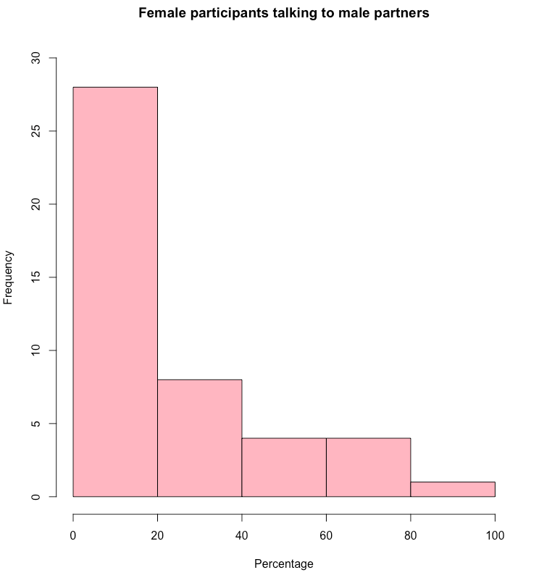
How often are Females talking to Males?
Female participants only, N=45
Valid Male Files
Total Valid Files

Slide 12
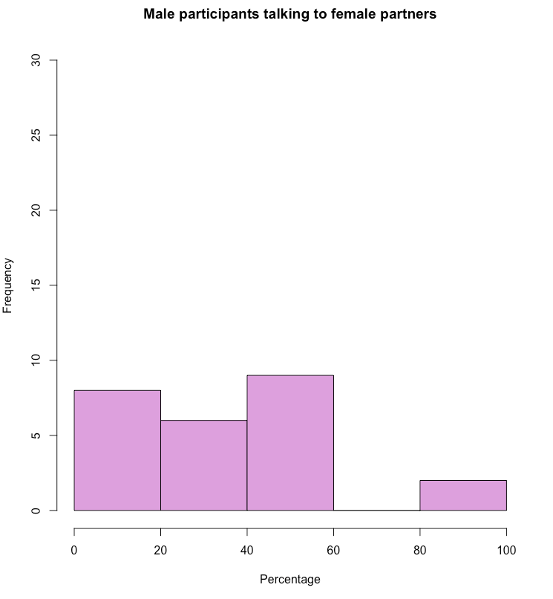
How often are Males talking to Females?
Male participants only, N=25
Valid Female Files
Total Valid Files

Slide 14
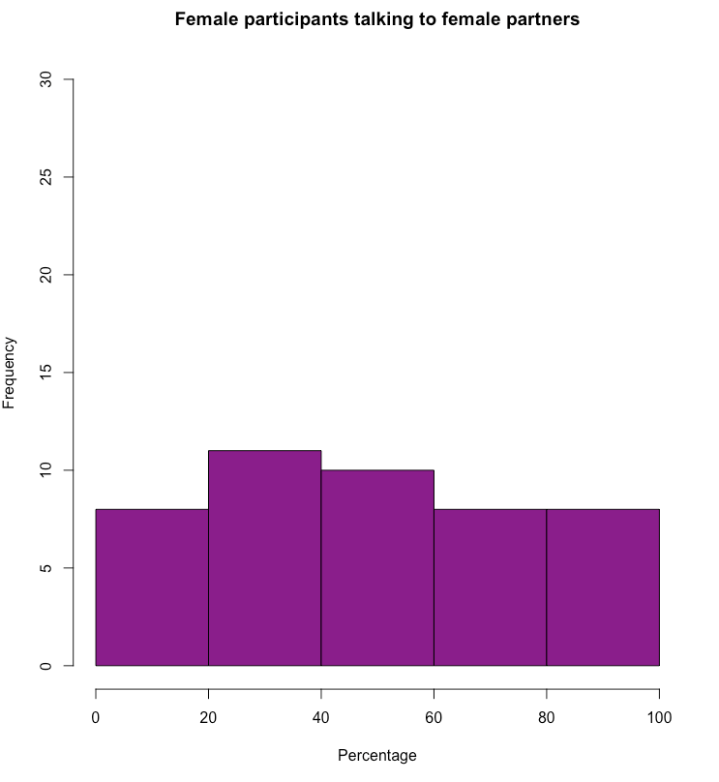

Slide 15
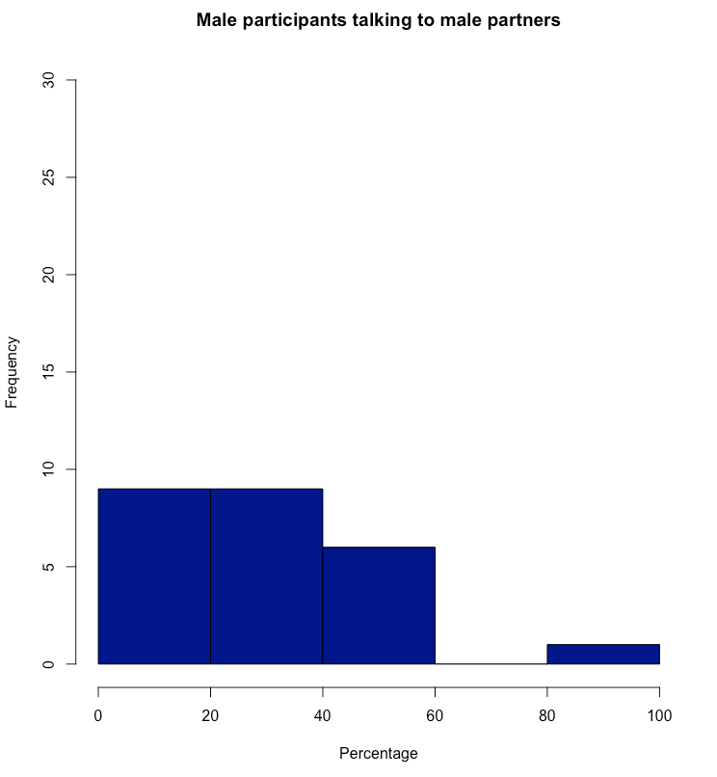

Slide 17
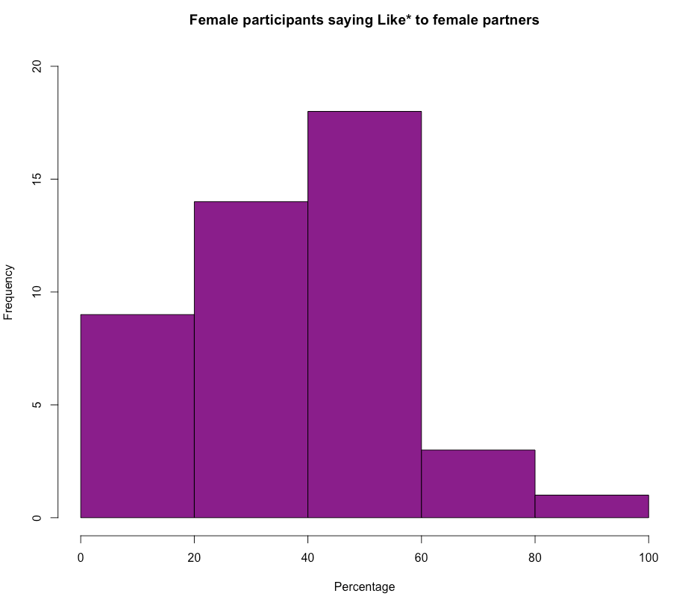
How often are Females saying Like* to Females?
Female participants only, N=45
Like* Files w/ Female
Valid Female Files

Slide 18
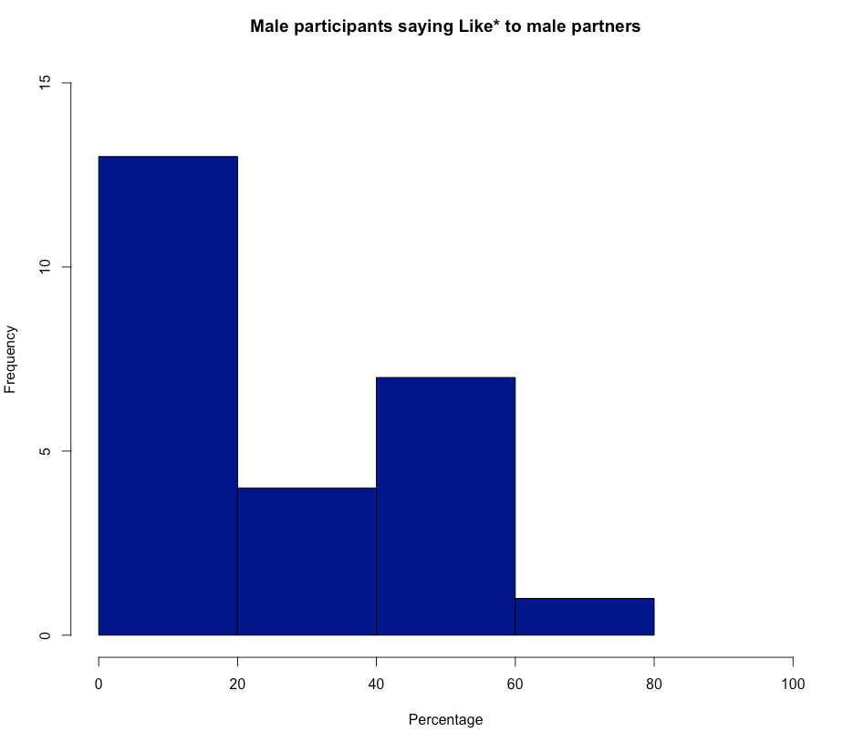
How often are Males saying Like* to Males?
Male participants only, N=25
Like* Files w/ Male
Valid Male Files

Slide 20
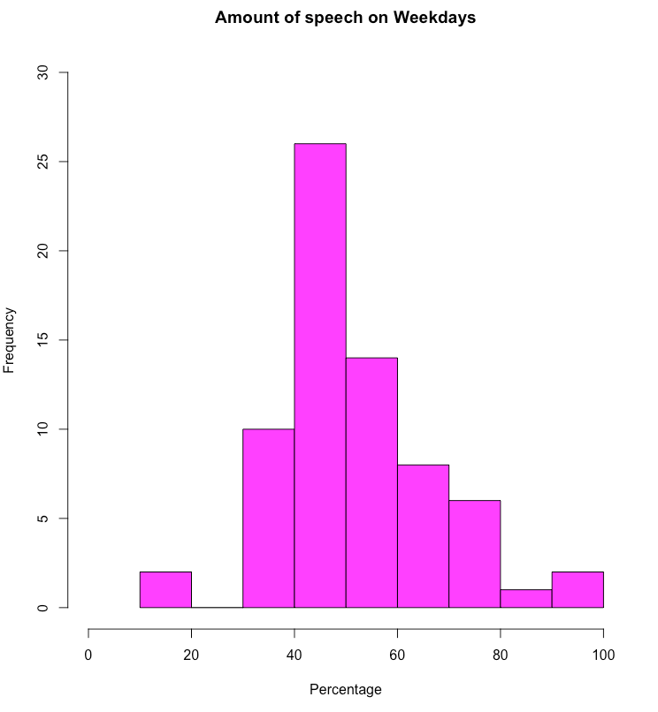
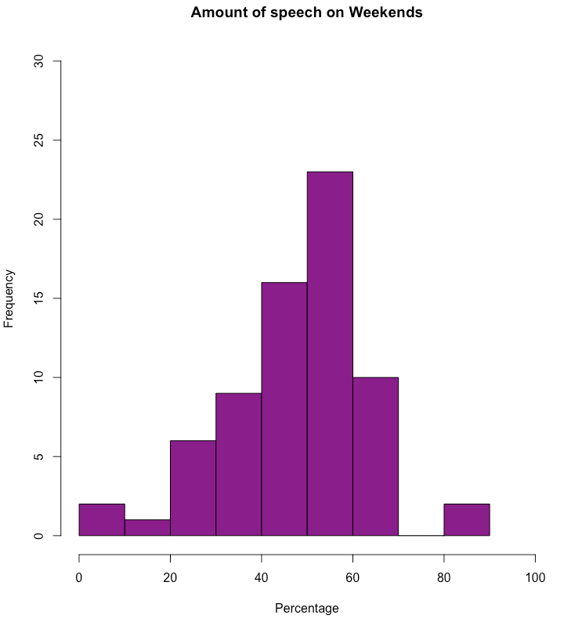
Do participants talk more on Weekdays vs. Weekends?
About the same, p=0.184

Slide 21
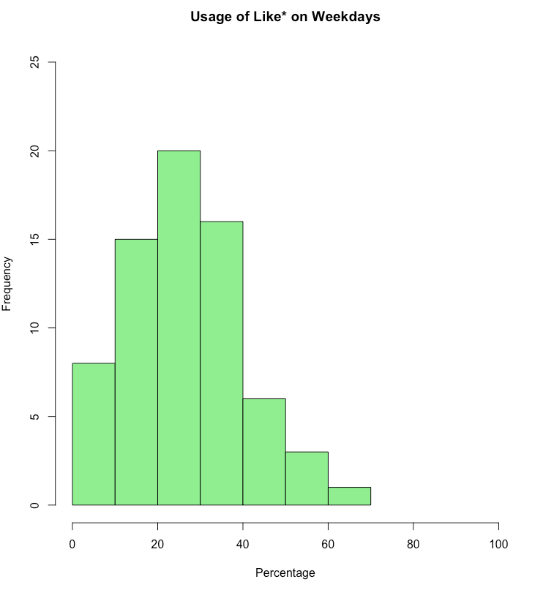
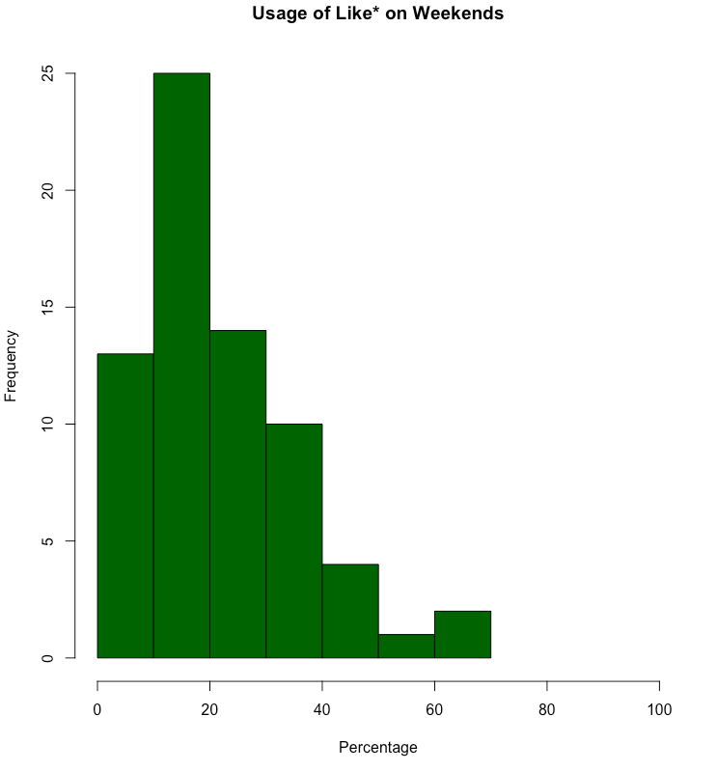
Do participants use Like* more on Weekdays vs. Weekends?
About the same, p=0.09

Slide 22
Which languages are spoken on the weekends?
Spanish – 22
Mandarin – 7
Vietnamese – 5
Farsi – 2
Arabic – 2
Burmese – 1
Cantonese – 1
Thai – 1
Russian – 1
Amahric – 1
Hindi - 1

